Slide 1

SAVEETHA SCHOOL OF ENGINEERING SIMATS, CHENNAI - 602105
CSA0695-DESIGN ANALYSIS AND ALGORITHMS
FOR OPEN ADDRESSING TECHNIQUES
Minimizing product selection for an e-commerce
Guided BY,
Dr. R. Dhanalakshmi
Presented by:-
A.MADHURI (19221187)

Slide 2
PROBLEM STATEMENT:
Context: An e-commerce platform, ShopMax, offers a diverse range of products to its customers. During sales events, the platform aims to showcase a selection of products on its homepage that maximizes customer engagement and potential revenue, given limited space.Problem: ShopMax needs to solve the Knapsack Problem to determine the optimal set of products to feature on the homepage. Given the constraints on space and the desire to maximize engagement and revenue, finding an exact solution is impractical, so an approximation algorithm is required.
Input:
1. Products: A set of products P=(p1.p2.....pn}P = \{p_1, p_2, \ldots, p_n\}P=(p1.p2
2.Values: Each product pip_ipi has an estimated revenue potential viv_ivi.
3. Sizes: Each product pip_ipi occupies a space sis_isi on the homepage.
4. Capacity: The maximum space SSS available on the homepage for featuring products.
Objective:
Design an approximation algorithm to determine the optimal set of products to feature on the homepage, such that:
1.The total estimated revenue potential of the selected products is maximized
2. The total space occupied by the selected products does not exceed the available space SSS

Slide 3
ABSTRACT:
This paper explores In the context of e-commerce platforms, providing customers with a vast array of product options can often lead to decision fatigue, resulting in decreased sales conversions and customer satisfaction. This research explores strategies to minimize product selection while maintaining relevance and maximizing user experience. Our findings demonstrate that a well-designed minimization strategy can improve user engagement, shorten decision-making time, and ultimately increase conversion rates, benefiting both customers and e-commerce platforms.
INTRODUCTION:
This paper aim Minimizing product selection without compromising on personalization and relevance has become a crucial challenge for e-commerce platforms. The goal is to help users quickly find products that align with their preferences while maintaining a seamless, engaging shopping experience. Achieving this balance requires the intelligent use of algorithms, user behavior analytics, and streamlined design approaches. This study explores various strategies and technologies, such as machine learning-driven recommendation systems, personalized search filters, and dynamic user interfaces, aimed at reducing the product selection pool.

Slide 4
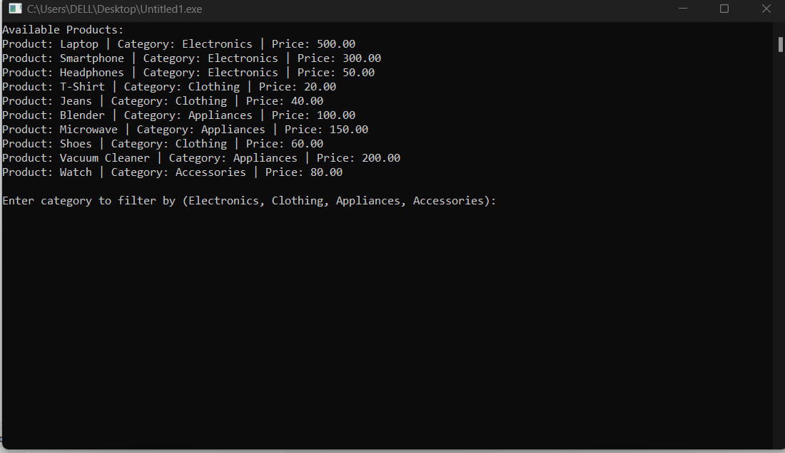
SAMPLE OUTPUT:

Slide 5
BEST CASE:
In the best case scenario, The best-case if the items are already sorted in decreasing order of value-to-weight ratio, you don't need to sort them, and the best case time complexity is 𝑂 ( 𝑛 ) O(n) for selecting the items. If the total weight of all items is less than or equal to the knapsack's capacity 𝑊.
Worst Case:
In the worst-case scenario, The worst-case For the 0/1 Knapsack Problem, the worst-case time complexity is O(2^n), which makes it an NP-complete problem.
Average Case:
The average case For the 0/1 Knapsack Problem, the average-case time complexity is typically:
1.O(nW) for Dynamic Programming (DP) algorithms.

Slide 6
Future Scope:
The future scope for Minimizing product selection in an e-commerce platform can improve user experience by making it easier for customers to find the right products without overwhelming them. This strategy is known as "curated shopping" or "personalized filtering." Here are some future trends and opportunities in this area. In improving user experience, optimizing inventory management, and personalized recommendations. The knapsack problem, which focuses on optimizing the selection of items given weight and value constraints, can be applied to minimize the overwhelming number of products shown to users while maximizing relevance and satisfaction.

Slide 7
CONCLUSION:
In conclusion, The Knapsack Problem is a classical optimization challenge with broad applications in resource allocation and decision-making. Dynamic Programming (0/1 Knapsack): Provides a polynomial-time solution with complexity 𝑂 ( 𝑛 𝑊 O(nW). Ideal for problems with bounded weights and values, though it can be computationally expensive for large capacities. The Knapsack Problem’s solution strategy depends on the problem variant and constraints. While dynamic programming and greedy approaches provide efficient solutions for their respective problem variants, understanding their complexities and trade-offs is crucial for applying them effectively to real-world scenarios.

Slide 8



